Slide 1
MIMIC III ML / DL
Diabetes Classification with MIMIC III data and UAE Data

Slide 2
Datasets used
The Problem
MIMIC III Dataset
Uae_hospital_diabetes_dataset_with_region_area
https://www.kaggle.com/datasets/walidbarghout/uae-hospital-diabetes-dataset-with-region-area?resource=download
- MIMIC 3 Diabetes Binary Classification
- uae_hospital_diabestes_datasets_with_region_area Diabetes Multi-Class Classification Using Deep Networks

Slide 3
Binary Diabetes Classification
Load Packages & MIMIC III Data
Data Engineering
Identify Diabetic Patients using ICD-9 Codes
Extract Patient Demographics
Extract Medications related to Diabetes
Extract Lab Features related to Diabetes
Combine All Features
Data Splitting
Train / Test Sets
Feature Importance with Random Forest
Evaluate Models
Logistic Regression
Random Forest
Gradient Boosting
Tuning Models
Hyperparameter Boosting
GridsearchCV
Visualization
Classification Metrics
Confusion Matrix
ROC Curve
Precision-Recall Curve
Feature Importance
Evaluate on Demo Patient
Prediction on patient data function
Save Model
Create Diabetes Classifier model with joblib

Slide 4
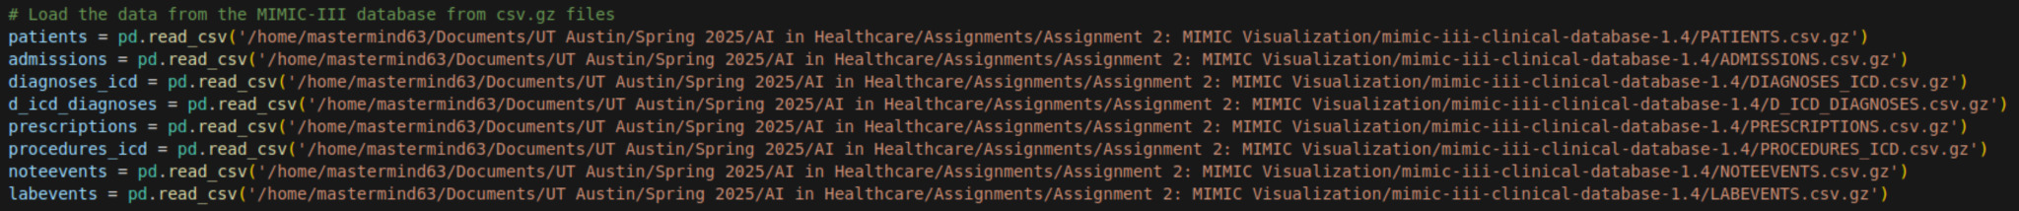
Load Packages & MIMIC III Data
Loading the following tables which contain data related to patients, their medications, their diagnosis, their lab data, and what types of procedures and events take place. This will be used as the basis for our understanding of who is diabetic and not, as well as a source of our training data depending on the importance of different features.

Slide 5
MIMIC III Binary Classifier - Data Engineering

Slide 6
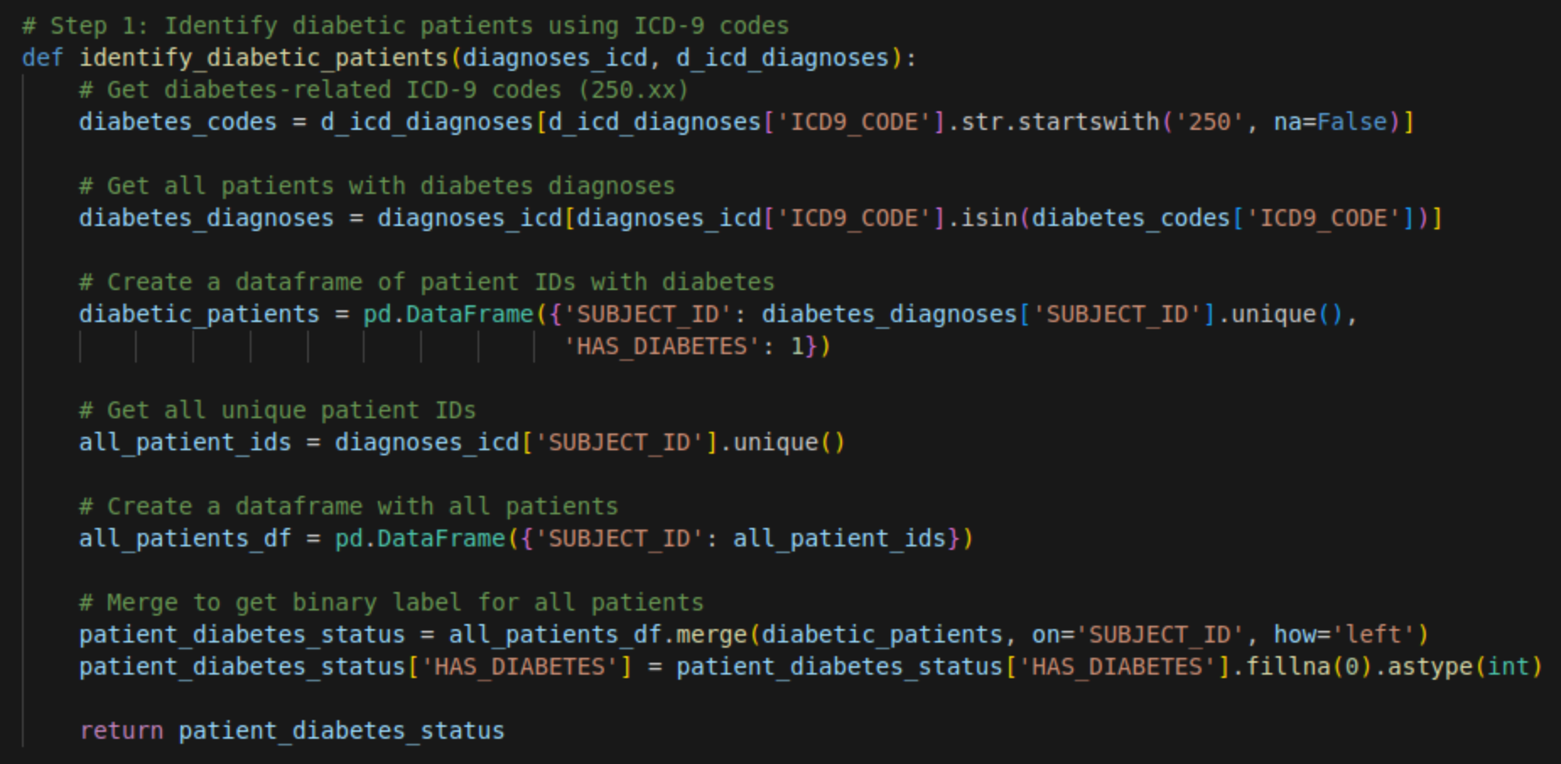
Data Engineering - Identifying Diabetics
The first step is to identify diabetics by their ICD-9 Codes, and create a diabetic flag for all of the patients in the dataset

Slide 7
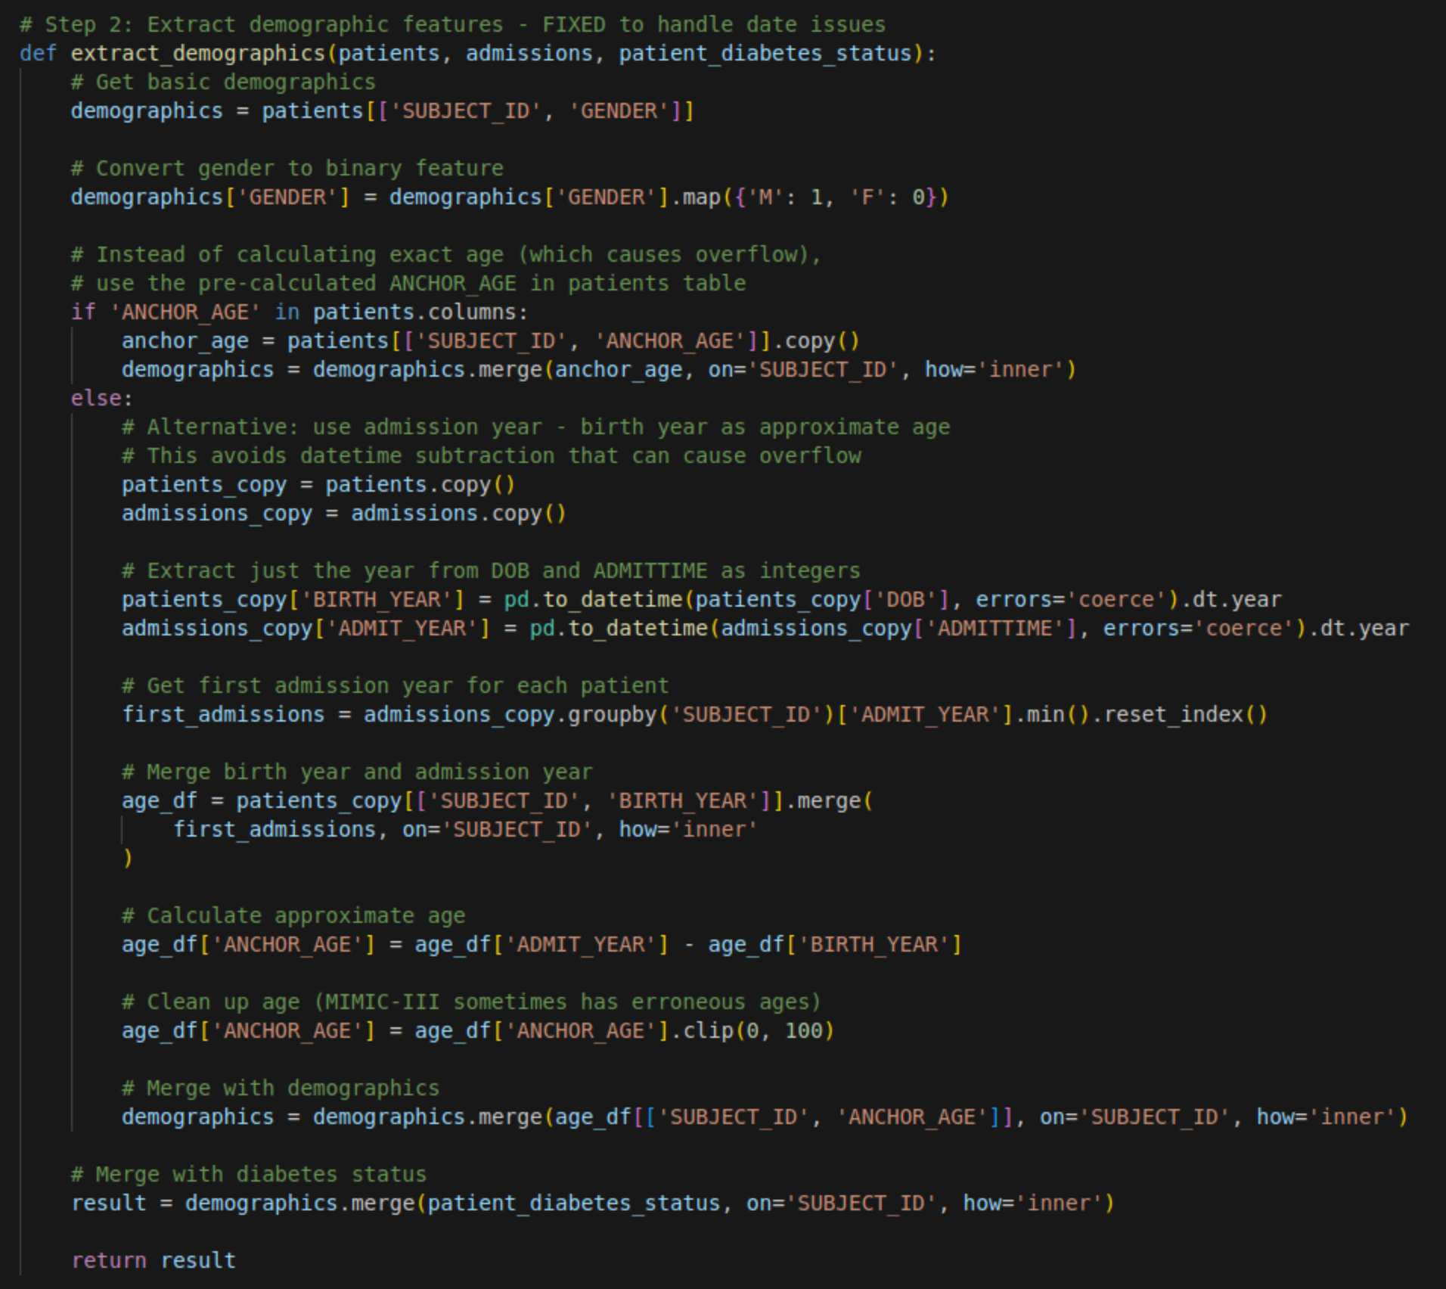
Data Engineering - Extract Demographics from patients and Admissions
The second step is to extract data about a patient's demographics like age and gender. This function extracts demographic features, including age and gender, from patient data and merges them with a pre-existing diabetes status label. It calculates age using either a provided anchor age or by subtracting birth year from admission year, handling potential date issues and erroneous age values.

Slide 8
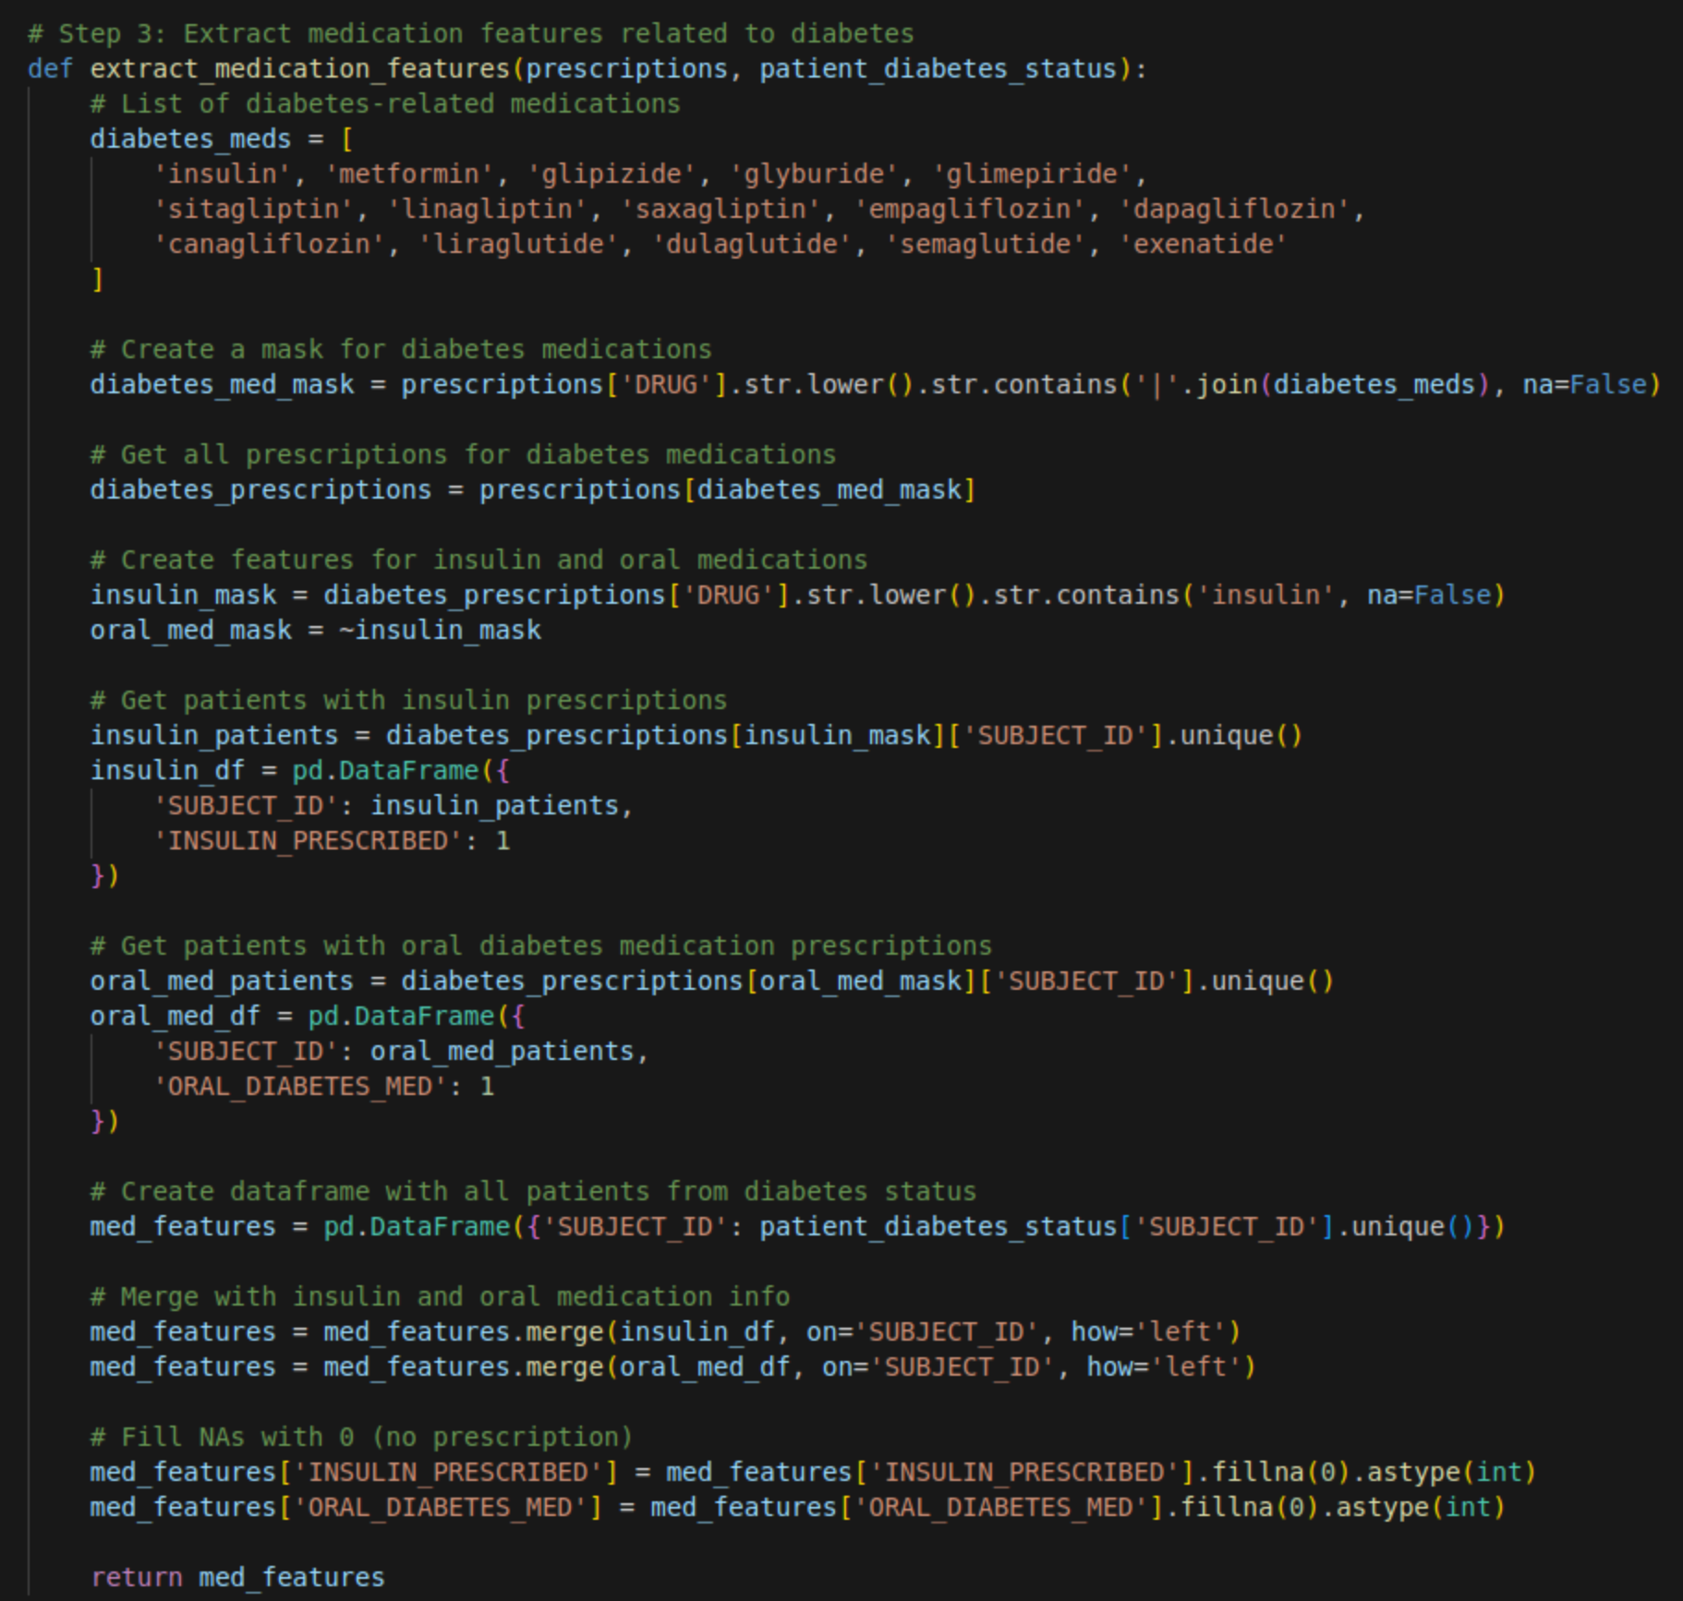
Data Engineering - Extract Medications Related to Diabetes
Next, we can enrich this data with flags related to certain medications which are used to treat diabetes. This function extracts medication features related to diabetes from prescription data and merges them with patient diabetes status. It identifies patients prescribed insulin and oral diabetes medications, creating binary features indicating their presence, and combines this information with the existing diabetes status label.

Slide 9
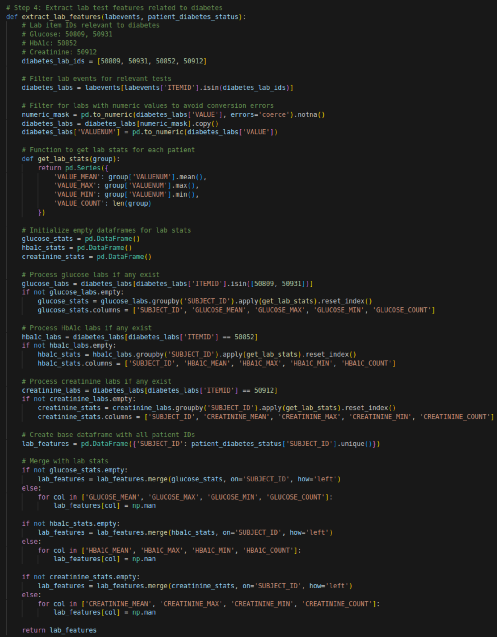
Data Engineering - Extract Lab Features related to Diabetes
Next, we further enrich this data using lab testing results which were collected on patients. This function extracts lab test features related to diabetes, including glucose, HbA1c, and creatinine levels, and merges them with patient diabetes status. It calculates mean, maximum, minimum, and count for each lab test per patient, handling potential conversion errors and missing data.

Slide 10
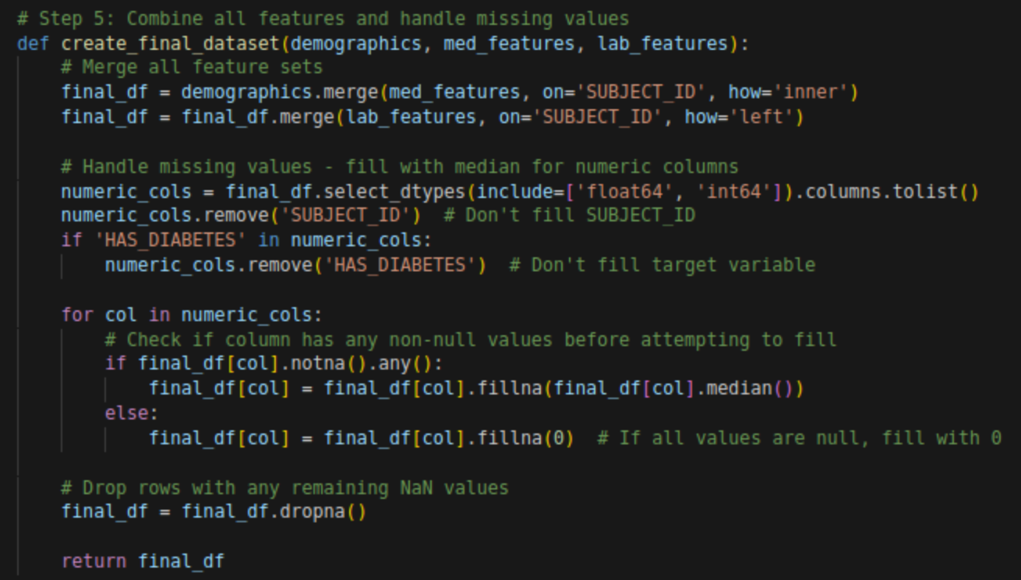
Data Engineering - Combine All Features

Slide 11
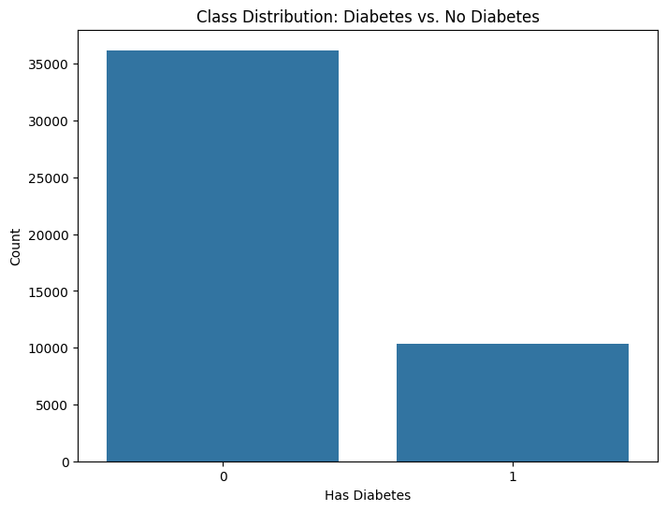
Data Engineering - Feature Statistics
Basic Statistics Summary
Demographics
Subjects: 46,520
Gender (Proportion Male): 56.2%
Average Age: 53.3 years
Diabetes & Medications
Has Diabetes: 22.2%
Insulin Prescribed: 55.6%
Oral Diabetes Medication: 6.4%
Glucose Levels (mg/dL)
Mean: 130.3 | Max: 3,565 | Min: -251
Glucose Count (Avg. Readings/Patient): 22.6
HbA1c Levels (%)
Mean: 6.1 | Max: 22.0 | Min: 3.3
HbA1c Count (Avg. Readings/Patient): 1.15
Creatinine Levels (mg/dL)
Mean: 1.20 | Max: 808 | Min: 0.0
Creatinine Count (Avg. Readings/Patient): 18.8

Slide 12
MIMIC III Binary Classifier - Data Splitting

Slide 13
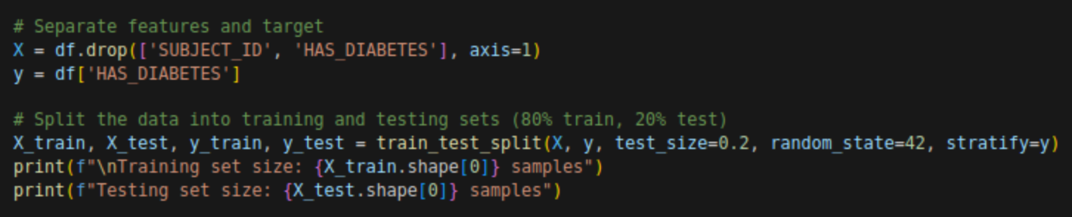
Data Splitting - Train / Test Sets
Splitting the data prepares a dataset for machine learning by separating features (X) from the target variable (y) and then splits the data into training and testing sets, ensuring a stratified split based on the target variable. Finally, it prints the number of samples in the training and testing sets. We will be using a split of 80% of our data for training, and another 20% of our data for testing.

Slide 14
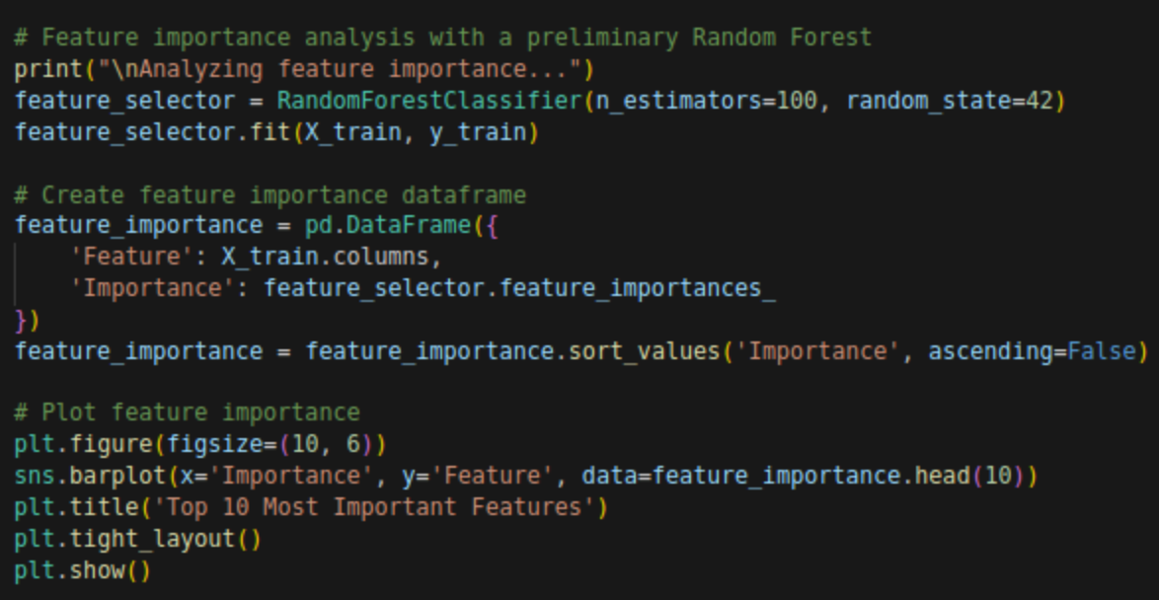
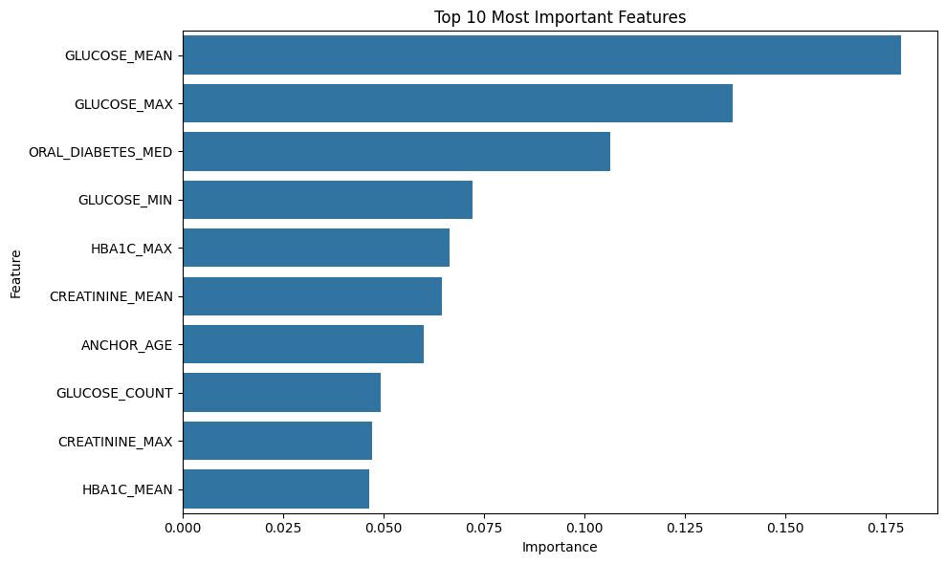
Data Splitting - Feature Importance with Random Forest
Top 10 most important features:
Feature Importance
4 GLUCOSE_MEAN 0.178965
5 GLUCOSE_MAX 0.137007
3 ORAL_DIABETES_MED 0.106570
6 GLUCOSE_MIN 0.072165
9 HBA1C_MAX 0.066582
12 CREATININE_MEAN 0.064529
1 ANCHOR_AGE 0.060151
7 GLUCOSE_COUNT 0.049301
13 CREATININE_MAX 0.047223
8 HBA1C_MEAN 0.046508

Slide 15
MIMIC III Binary Classifier - Evaluate Models

Slide 16
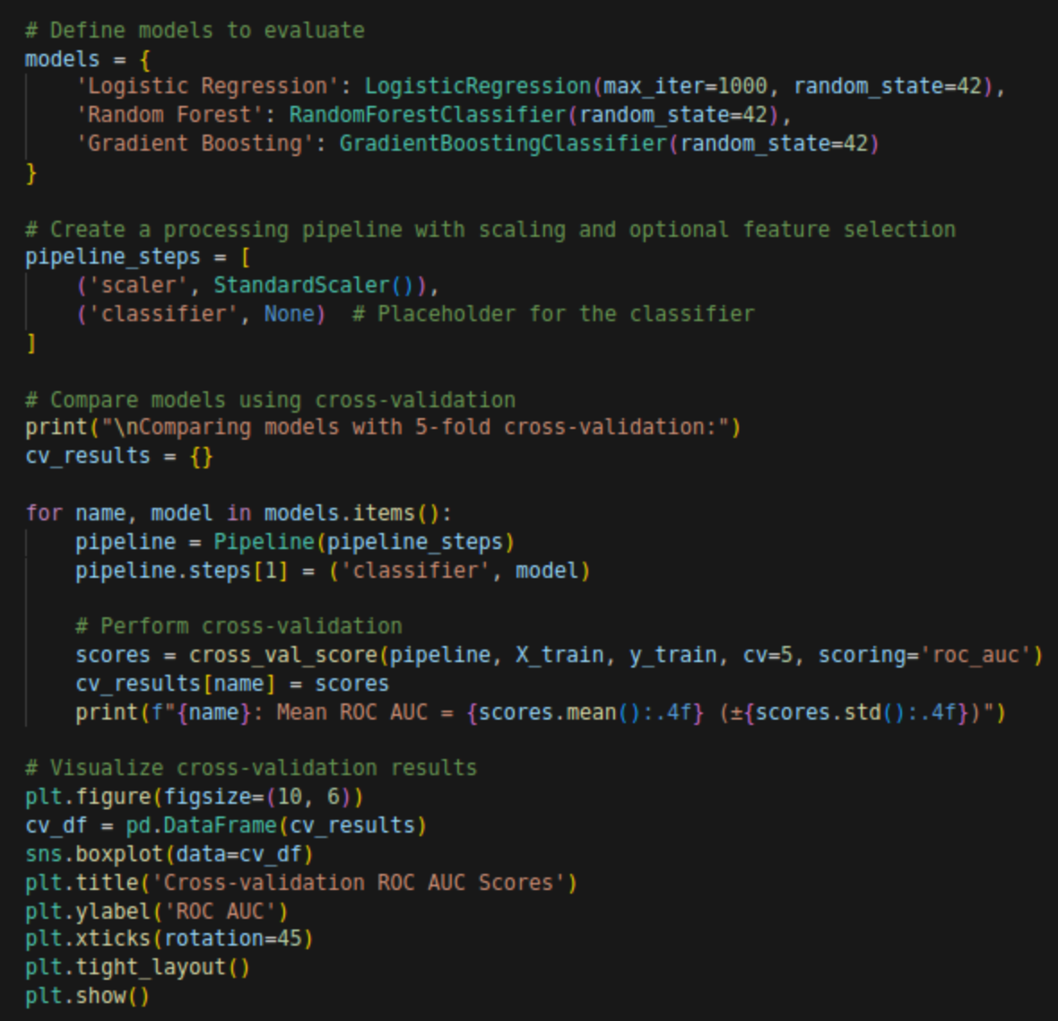
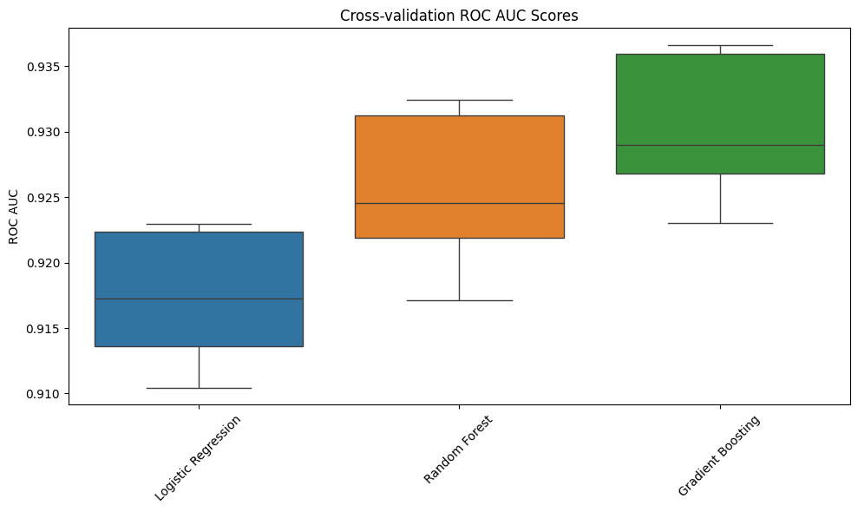
Evaluate Models - Defining Models & Training Pipeline
Comparing models with 5-fold cross-validation:
Logistic Regression: Mean ROC AUC = 0.9173 (±0.0048)
Random Forest: Mean ROC AUC = 0.9254 (±0.0058)
Gradient Boosting: Mean ROC AUC = 0.9303 (±0.0053)
This code trains, evaluates (using cross-validation), and visualizes the performance of three machine learning models (Logistic Regression, Random Forest, and Gradient Boosting) based on their ROC AUC scores.

Slide 17
MIMIC III Binary Classifier - Tuning Models

Slide 18
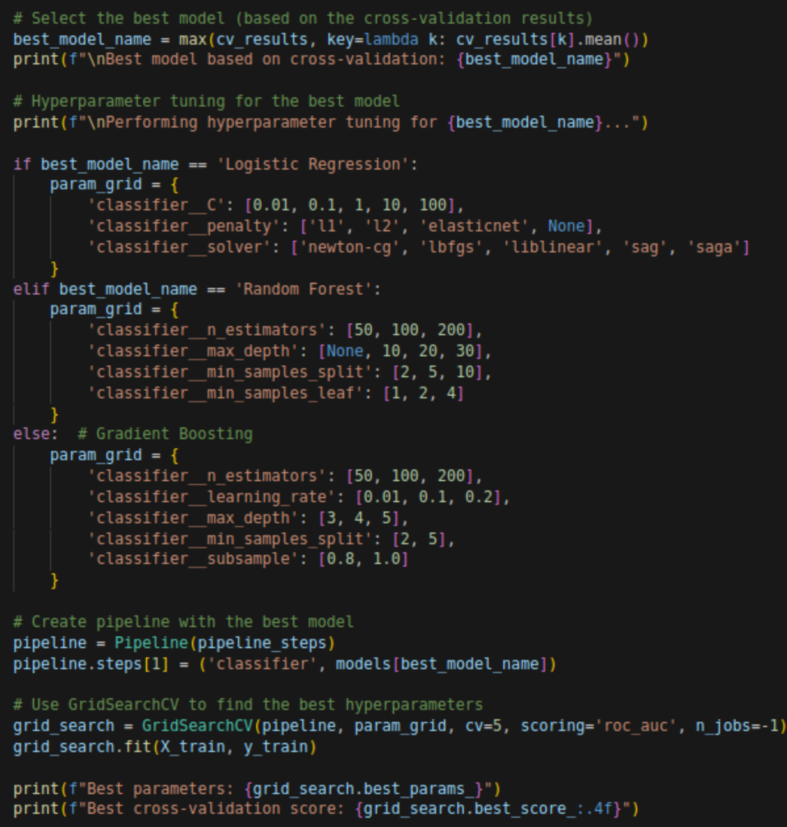
Tuning Models - Hyperparameter Tuning for Gradient Boosting
This tuning step dynamically selects the best performing model from a set of trained models based on their cross-validation results, then performs hyperparameter tuning using GridSearchCV to optimize its performance. It defines a parameter grid specific to the chosen model and fits the grid search to find the best combination of hyperparameters. Finally, it prints the best parameters and the corresponding best cross-validation score achieved by the tuned model.

Slide 19
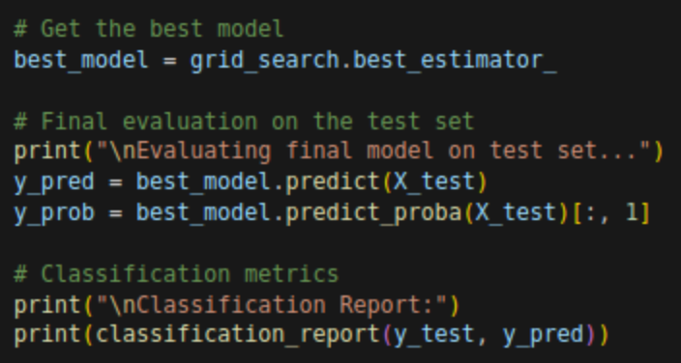
Tuning Models - GridsearchCV & Training
The code extracts the optimal model discovered during hyperparameter tuning and evaluates its performance on the held-out test set. It then trains a model using those found hyperparameters. Using this model, it generates and displays a classification report.
Classification Report:
precision recall f1-score support
0 0.91 0.95 0.93 7240
1 0.80 0.67 0.73 2064
accuracy 0.89 9304
macro avg 0.85 0.81 0.83 9304
weighted avg 0.88 0.89 0.89 9304

Slide 20
MIMIC III Binary Classifier - Visualization

Slide 21
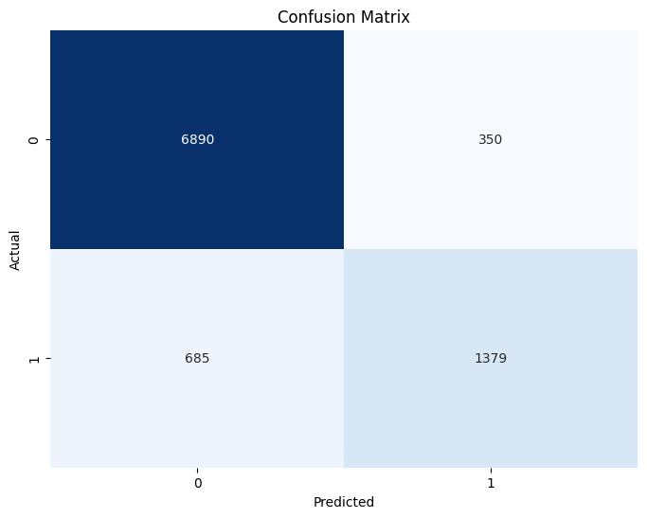
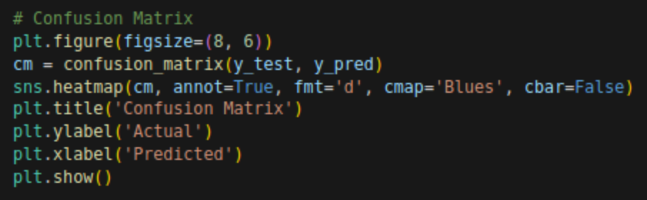
Visualization - Confusion Matrix
The model accurately predicted 6890 individuals without diabetes and 1379 individuals with diabetes. However, it misclassified 350 healthy individuals as having diabetes and failed to identify 685 individuals who truly had the condition. This indicates a potential issue with the model's sensitivity in detecting positive cases, which is crucial in a medical context like diabetes prediction.

Slide 22
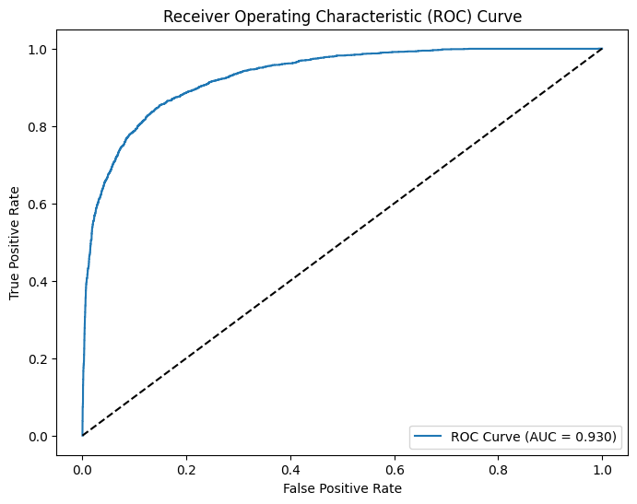
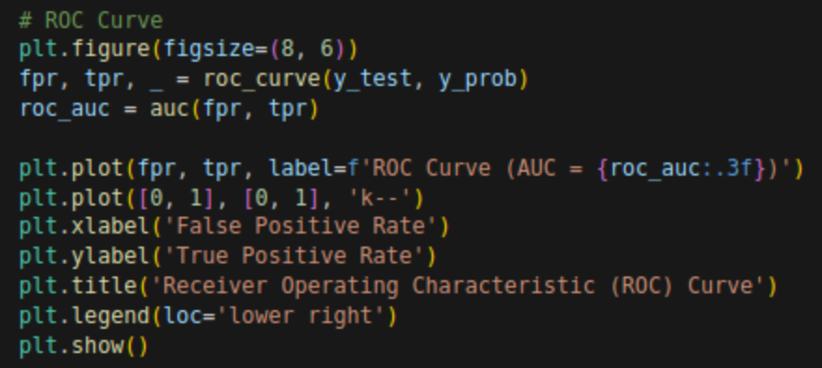
Visualization - ROC Curve
This ROC curve illustrates the performance of a diabetes prediction model, plotting the True Positive Rate (sensitivity) against the False Positive Rate (1-specificity) at various threshold settings. The curve rises sharply towards the top-left corner, indicating a high True Positive Rate with a low False Positive Rate, which signifies good discriminatory ability. The Area Under the Curve (AUC) is 0.930, suggesting the model has an excellent ability to distinguish between individuals with and without diabetes. This high AUC score implies the model is effective in ranking individuals based on their risk of diabetes.

Slide 23
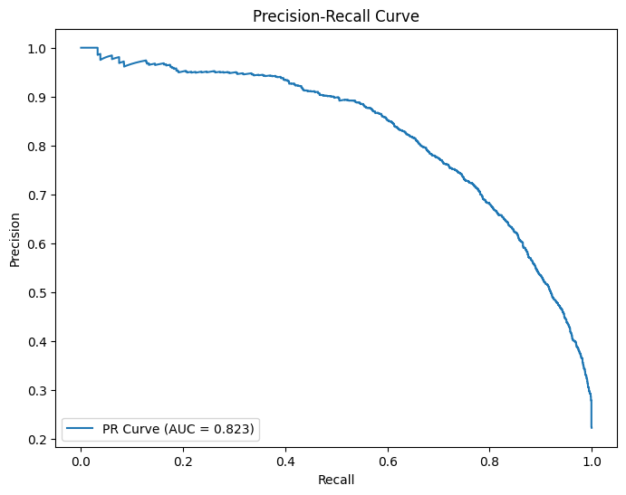
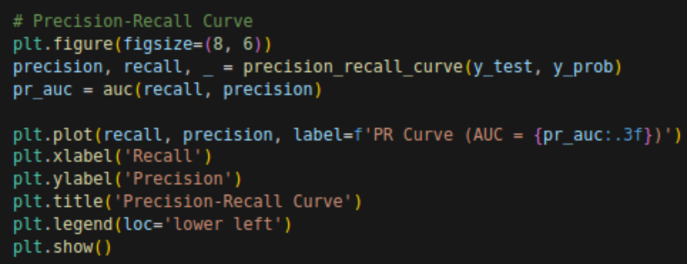
Visualization - Precision-Recall Curve
This Precision-Recall curve displays the trade-off between precision (the proportion of correctly predicted positive cases) and recall (the proportion of actual positive cases correctly identified) for the diabetes prediction model. The curve shows a high precision at low recall values, indicating the model is very accurate when it predicts diabetes, but it misses many actual cases. As recall increases, precision decreases, suggesting the model becomes less accurate at identifying all positive cases. The Area Under the Curve (AUC) of 0.823 indicates a good balance between precision and recall, but also highlights the potential for improvement in capturing all positive cases without sacrificing precision.

Slide 24
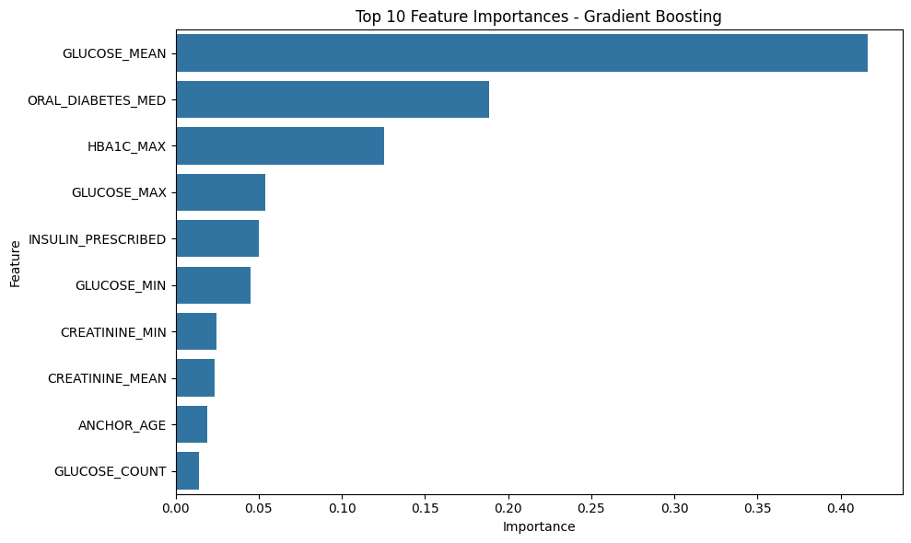
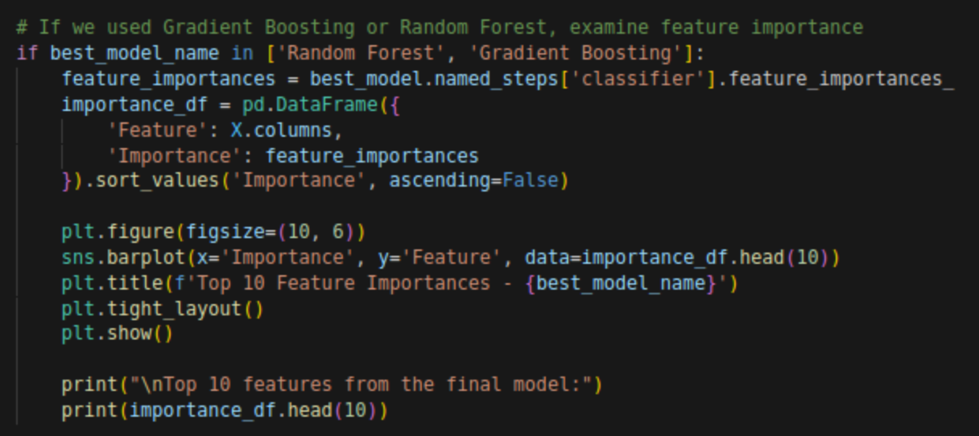
Visualization - Feature Importance
Top 10 features from the final model:
Feature Importance
4 GLUCOSE_MEAN 0.416511
3 ORAL_DIABETES_MED 0.188321
9 HBA1C_MAX 0.125149
5 GLUCOSE_MAX 0.053727
2 INSULIN_PRESCRIBED 0.049990
6 GLUCOSE_MIN 0.045220
14 CREATININE_MIN 0.024464
12 CREATININE_MEAN 0.023523
1 ANCHOR_AGE 0.019192
7 GLUCOSE_COUNT 0.014230
This horizontal bar chart displays the top 10 most important features identified by a Gradient Boosting model for predicting diabetes. The "GLUCOSE_MEAN" is the most influential feature, significantly outweighing all others in importance. "ORAL_DIABETES_MED" and "HBA1C_MAX" also play a substantial role, while features like "GLUCOSE_COUNT" and "ANCHOR_AGE" have relatively low importance in the model's predictions. This visualization helps understand which factors the model relies on most heavily when determining diabetes risk.

Slide 25
MIMIC III Binary Classifier - Evaluate Patient

Slide 26
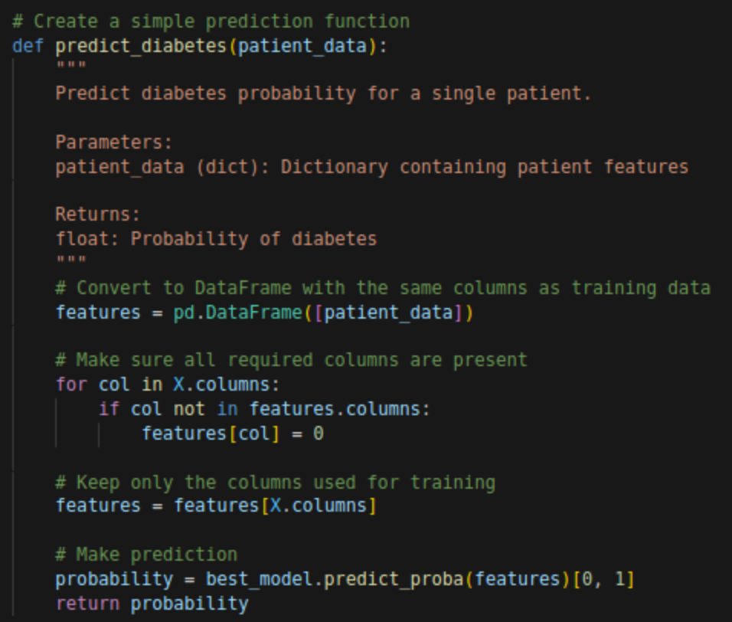
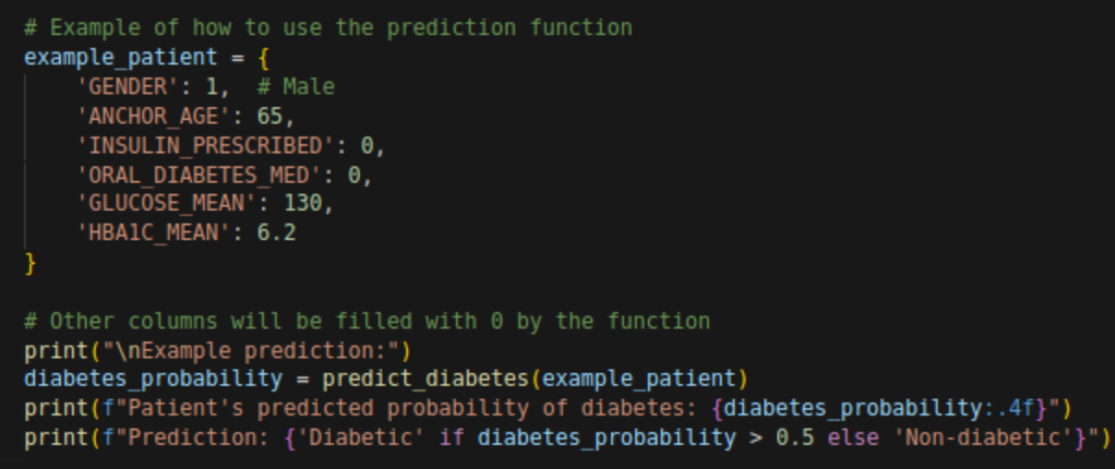
Evaluate Patient - Predicting outcomes
Example prediction:
Patient's predicted probability of diabetes: 0.2522
Prediction: Non-diabetic
With information about a given patient, such as age, gender, If insulin or oral diabetes meds were prescribed, and someone's glucose mean and HBA1C mean, you can predict their likelihood of being diabetic.

Slide 27
MIMIC III Binary Classifier - Save Model

Slide 28
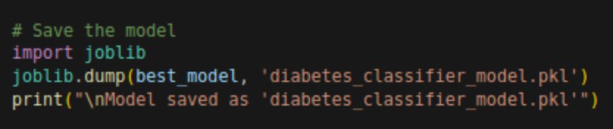
Save Model - joblib Library
Model is saved and uploaded for future use, if other’s would like to test this classifier or use it for their own datasets

Slide 29
Bonus
Multiclass Classification is a Harder Problem, but can be more useful for determining what stage of a disease like Diabetes someone is in
Uae_hospital_diabetes_dataset Multi-Class Classification

Slide 30
Multi-Class Diabetes Classification
Understanding the Dataset
Data Engineering
Clean Data
Encode Categories
Extract time from visit & additional features
Evaluate Models
Gradient Boosting
Neural Network
Random Forest
Conclusion

Slide 31
Bonus - Understanding the Dataset (UAE Diabetes Test Set)
This dataset contains patient visit information, including demographics, diagnosis, insurance status, and service costs, focusing on various diabetes types. The target variable, 'Diagnosis', shows a distribution heavily skewed towards Type 2 and Type 1 diabetes, with other types and 'Unknown' diagnoses present. This is analogous to what we see in the population, but may make training multiclass challenging. Analysis of this data can reveal patterns in healthcare utilization and costs associated with different diabetes diagnoses.
Unique Values in Diagnosis:
['Type 1 Diabetes' 'Type 2 Diabetes' 'Prediabetes' 'Type 3 Diabetes'
'Gestational Diabetes' 'Unknown' ' ']
Target Variable Distribution:
Diagnosis
Type 2 Diabetes 346440
Type 1 Diabetes 49518
Prediabetes 49143
Gestational Diabetes 24582
Type 3 Diabetes 15486
14846
Unknown 4910
Name: count, dtype: int64
Diagnosis
Type 2 Diabetes 0.686122
Type 1 Diabetes 0.098070
Prediabetes 0.097327
Gestational Diabetes 0.048684
Type 3 Diabetes 0.030670
0.029402
Unknown 0.009724
Name: proportion, dtype: float64

Slide 32
Bonus - Data Engineering

Slide 33
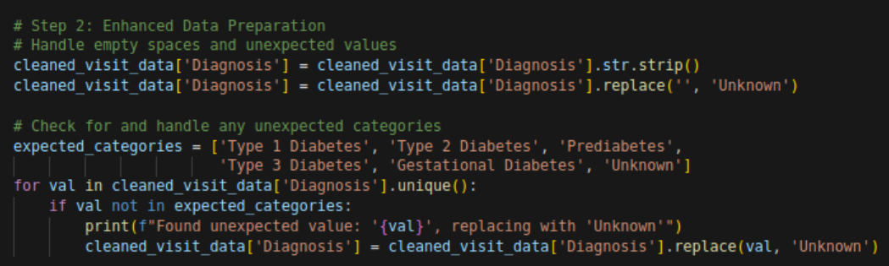
Data Engineering - Clean Data
This code segment performs data cleaning and standardization on a 'Diagnosis' column within a Pandas DataFrame named 'cleaned_visit_data'. It first removes leading/trailing spaces from the string values in the 'Diagnosis' column and replaces any empty strings with "Unknown". Subsequently, it checks for any unexpected categories within the 'Diagnosis' column, comparing them to a predefined list of expected categories, and replaces any unexpected values with "Unknown" while printing a message indicating the change.

Slide 34
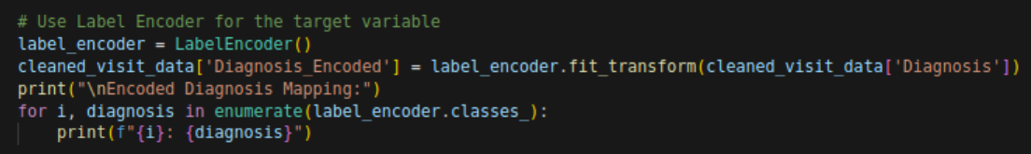
Data Engineering - Encode Categories
Encoded Diagnosis Mapping:
0: Gestational Diabetes
1: Prediabetes
2: Type 1 Diabetes
3: Type 2 Diabetes
4: Type 3 Diabetes
5: Unknown
Class weights:
Class 0: 3.4233
Class 1: 1.7125
Class 2: 1.6995
Class 3: 0.2429
Class 4: 5.4341
Class 5: 4.2596
This slide details the encoding of the 'Diagnosis' categorical variable using Label Encoding, mapping each unique diagnosis to a numerical representation. The resulting encoded values are then used to calculate class weights, addressing the class imbalance evident in the training set distribution. The class weights are inversely proportional to the class frequencies, giving higher importance to minority classes during model training.
Class distribution in training set:
Class 0 (Gestational Diabetes): 19666 samples (4.87%)
Class 1 (Prediabetes): 39314 samples (9.73%)
Class 2 (Type 1 Diabetes): 39614 samples (9.81%)
Class 3 (Type 2 Diabetes): 277152 samples (68.61%)
Class 4 (Type 3 Diabetes): 12389 samples (3.07%)
Class 5 (Unknown): 15805 samples (3.91%)

Slide 35
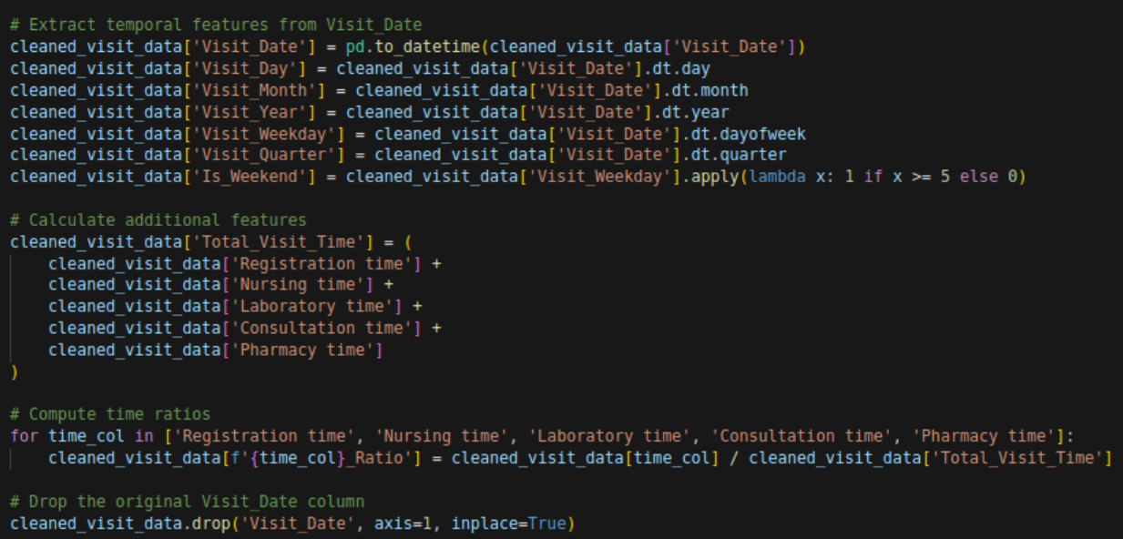
Data Engineering - Extract Time from Visit & Additional Features

Slide 36
Bonus - Evaluate Models

Slide 37
Evaluate Models - Gradient Boosting
Gradient Boosting worked fairly well, but seemed to only be able to predict Type 1 and Type 3 Diabetes. Despite having a higher accuracy, this model would not be ideal for multi-class classification, as it was unable to reliably detect all classes.
--- Training a Gradient Boosting model first ---
Gradient Boosting Accuracy: 0.6995
Classification Report (Gradient Boosting):
precision recall f1-score support
Gestational Diabetes 0.08 0.00 0.00 4916
Prediabetes 0.00 0.00 0.00 9829
Type 1 Diabetes 0.00 0.00 0.00 9904
Type 2 Diabetes 0.70 0.99 0.82 69288
Type 3 Diabetes 0.69 0.64 0.66 3097
Unknown 0.00 0.00 0.00 3951
accuracy 0.70 100985
macro avg 0.24 0.27 0.25 100985
weighted avg 0.51 0.70 0.58 100985

Slide 38
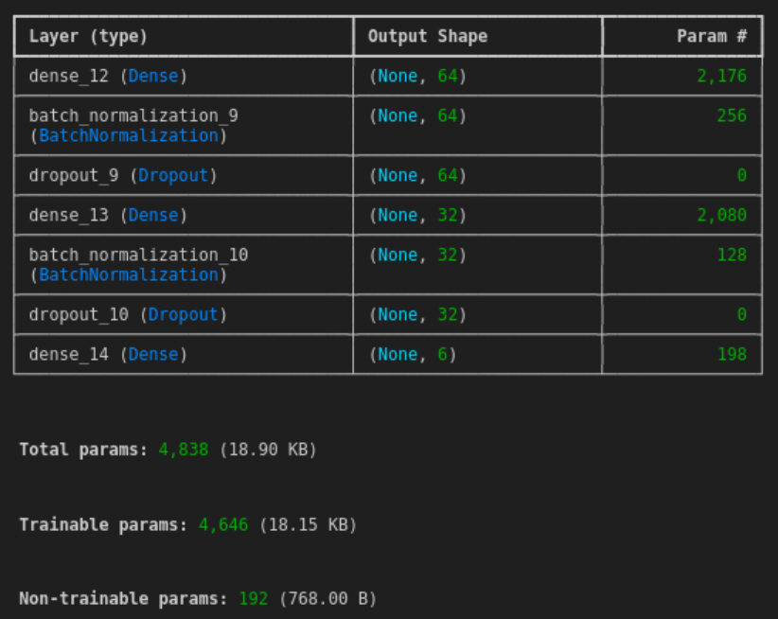
Evaluate Models - Neural Network
Neural Network Accuracy: 0.2970
Classification Report (Neural Network):
precision recall f1-score support
Gestational Diabetes 0.05 0.39 0.09 4916
Prediabetes 0.10 0.04 0.05 9829
Type 1 Diabetes 0.10 0.16 0.12 9904
Type 2 Diabetes 0.70 0.34 0.46 69288
Type 3 Diabetes 0.62 0.68 0.65 3097
Unknown 0.04 0.05 0.04 3951
accuracy 0.30 100985
macro avg 0.27 0.28 0.24 100985
weighted avg 0.52 0.30 0.36 100985
Here we see very limited success of the neural network. Despite multiple layers, dropout, and a large number of parameters, it would seem there is not enough data on unknown, Type 1, Prediabetes, or Gestational Diabetes cases to make accurate predictions. Despite this, the Neural Network does make attempts at predicting diabetes in these cases, and classifies them better than either gradient boosting or the random forest classifier.

Slide 39
Evaluate Models - Random Forest
Top 10 most important features:
Total_Visit_Time: 0.1779
Registration time: 0.1464
Laboratory time: 0.1350
Pharmacy time: 0.1300
Nursing time: 0.1211
Total_Cost: 0.1152
Consultation time: 0.1037
Registration time_Ratio: 0.0086
Consultation time_Ratio: 0.0083
Pharmacy time_Ratio: 0.0082
This model just barely beats gradient boosting to have been our most effective classifier for this dataset. Given this information, I believe that with further training a neural network could be the most effective classifier, as it was still able to understand some information about the other classes. Random forest did not predict any of the less represented classes in the data.
--- Training a Random Forest model ---
Random Forest Accuracy: 0.7001
Classification Report (Random Forest):
precision recall f1-score support
Gestational Diabetes 0.00 0.00 0.00 4916
Prediabetes 0.00 0.00 0.00 9829
Type 1 Diabetes 0.00 0.00 0.00 9904
Type 2 Diabetes 0.70 0.99 0.82 69288
Type 3 Diabetes 0.68 0.67 0.68 3097
Unknown 0.00 0.00 0.00 3951
accuracy 0.70 100985
macro avg 0.23 0.28 0.25 100985
weighted avg 0.50 0.70 0.58 100985

Slide 40
Conclusion

Slide 41
Comparing Binary and Multi-Class Prediction
The binary classification we were doing earlier using MIMIC III data relied on a large number of chart notes, drug and prescription data, and intake information that allowed for correlations to be made over the 60k patient dataset. This allowed for an extremely accurate classifier to determine whether or not a patient had diabetes. Multi-Class Classification struggles from the problem of uneven distributions of the class to be predicted. While weighting different training data allowed better training overall, only a neural network was able to capture the variances and predict classes less frequent than 10%. The classifiers were exported for potential future use or training.

